Slide 1


Szendrő Városi Sport- és Szabadidő Klub
Természetjáró Szakosztály
XII. Vitézlő
International Challenge Tours
April 21-23, 2017

Slide 2
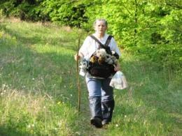
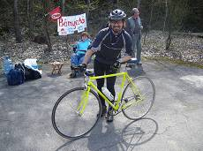
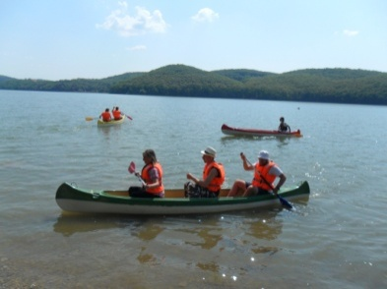
International Challenge Tours in the Aggtelek Karst and the Heart of the Cserehát
Hiking:
      10 km
      15 km
      25 km and canoe
      35 km
      50 km
Cycling:
      50, 80, 100 km – may be combined with canoe trip
New in 2017:
      Olympic Pentathlon series of events
      100 km bike tour
      New clean up activity, competition

Slide 3
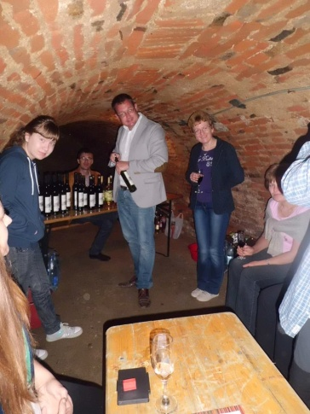
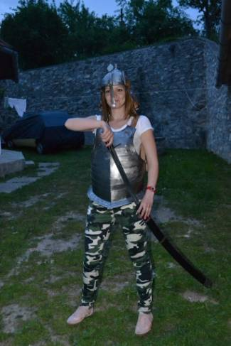
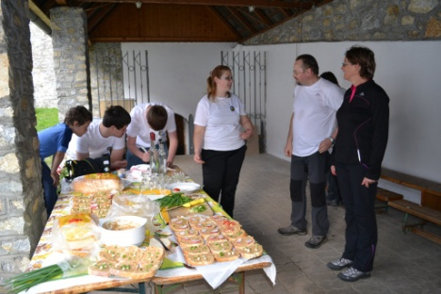
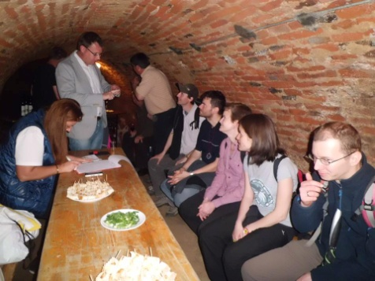

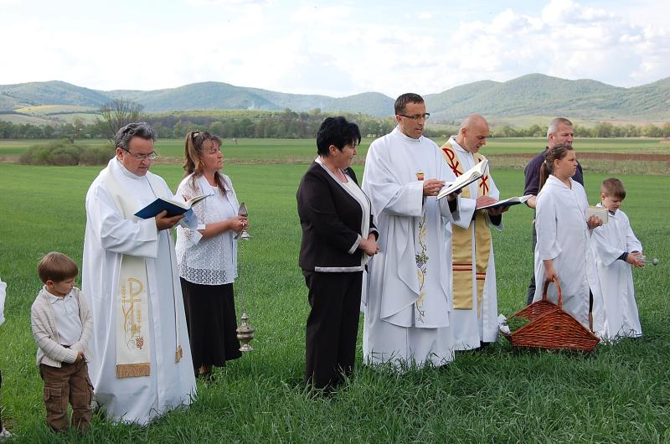


Vitézlő Additional Programmes
Wine Cellar Tour, Friday, April 21:
Additional programmes with Vitézlő partners, Sunday, April 23:
Visit Edelény’s Castle Island!
Blessing of the Wheat Harvest in Dobódél
Cave Tours at Aggtelek National Park
Canoe Trips

Slide 4

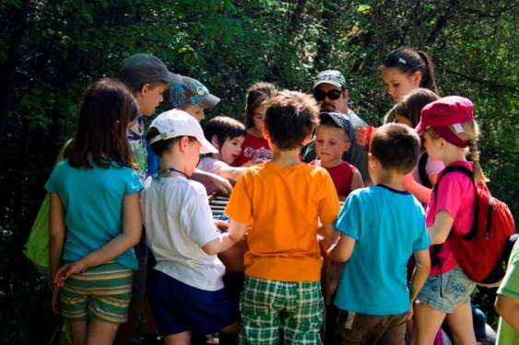
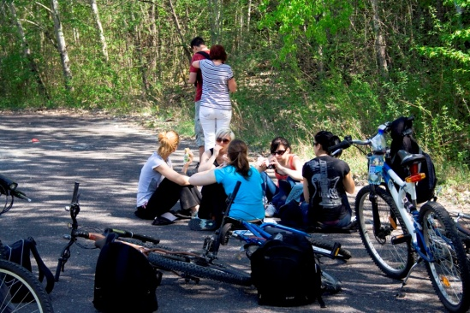
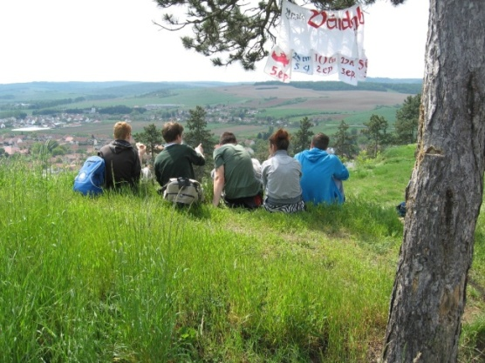
Vitézlő Target Groups
  Families: programmes for multiple generations
  Students
  Nature lovers
  Challenge tourists (hiking, biking)
  Locals and visitors
  Organisations: scouts, church groups…

Slide 5

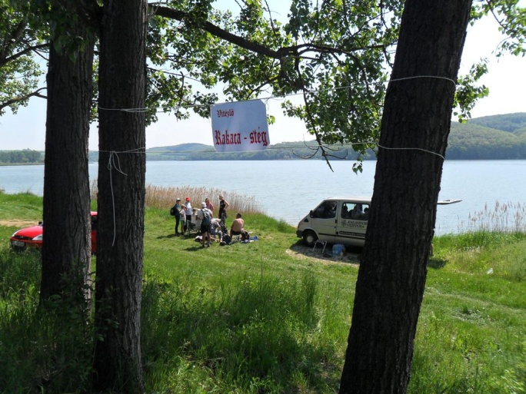
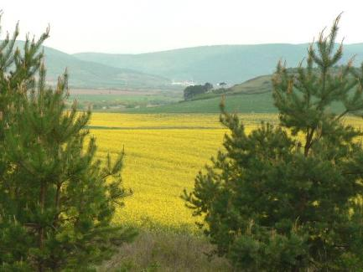
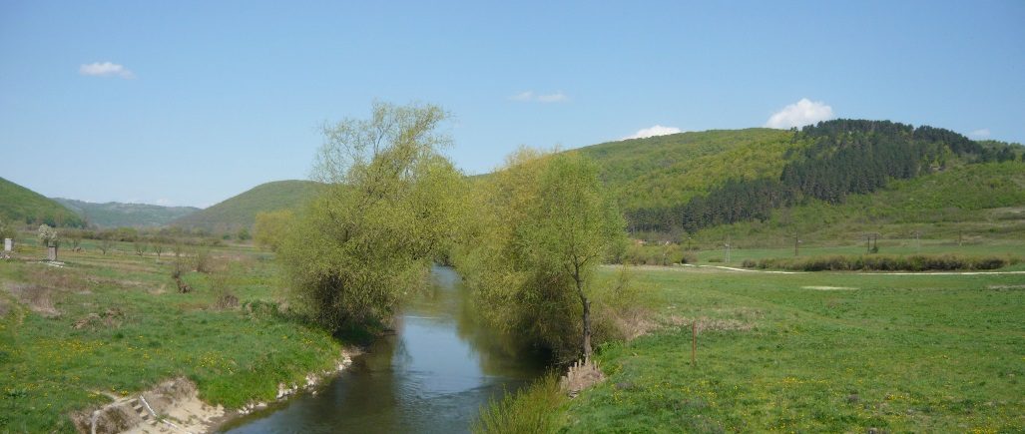
What is so interesting?
  Exciting hikes in less well-known locations;
  Amazing natural surroundings;
  Cultural and historical sites;
  Tons of surprises and prizes; and
  High quality organisation.

Slide 6
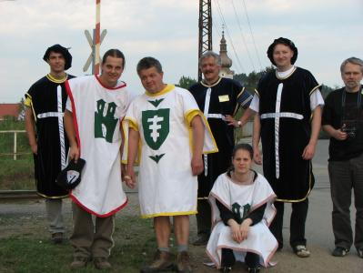
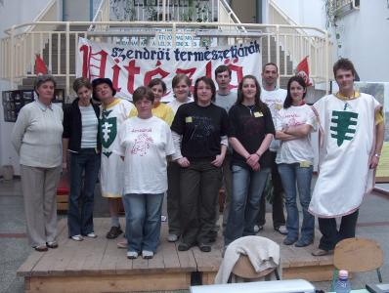
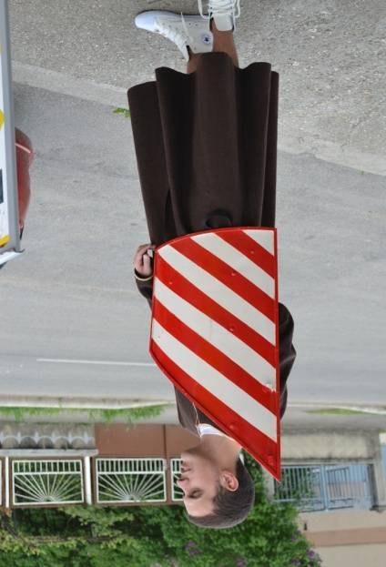
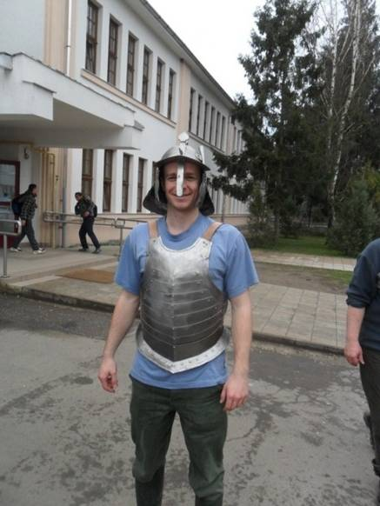
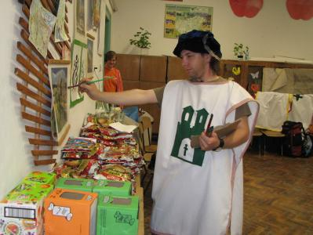
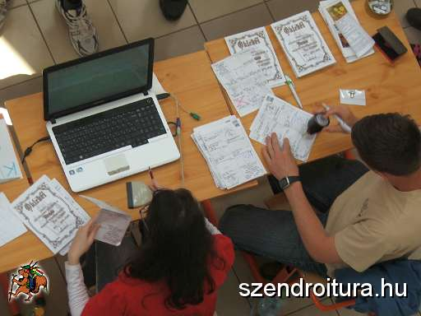
Who’s behind the scenes?
  A dedicated team of young people;
  21st century organisational solutions;
  Cooperation agreements with several partner organisations;
  Sponsors, business connections;
  Volunteer organising team; and
  Long-term planning.

Slide 7

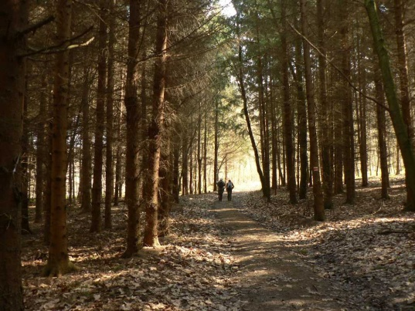
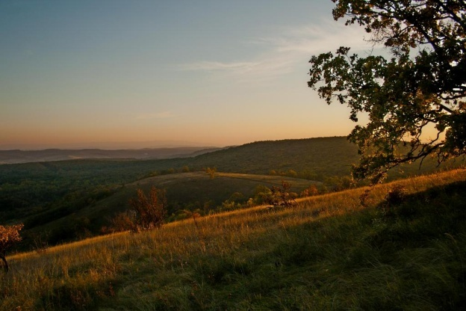
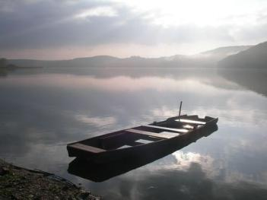
Vitézlő ‘s Professional Reputation
The event includes an Olympic Pentathalon.
The event has twice been a component of the Cartographic Cup.
Based on its family friendliness, good organisation, the success of past events and its welcoming atmosphere, the event has qualified to be a part of the IVV International Tourist Movement for the seventh time.

Slide 8
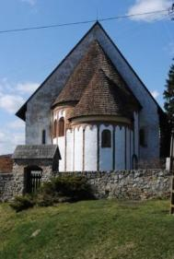
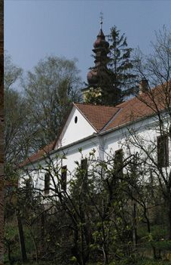
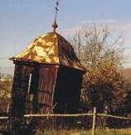
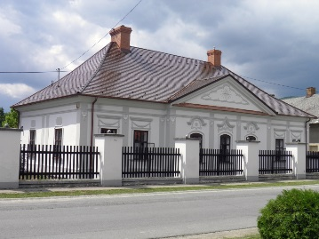
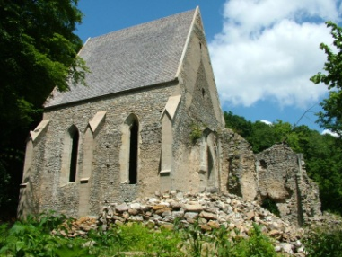
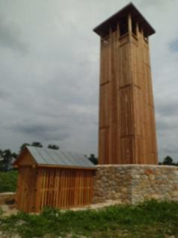
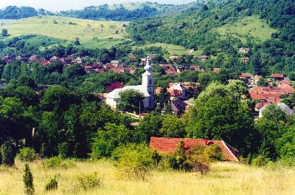
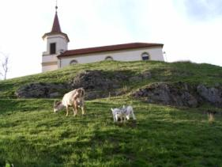
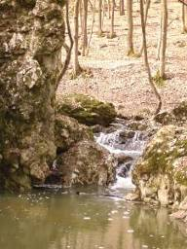
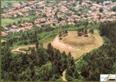
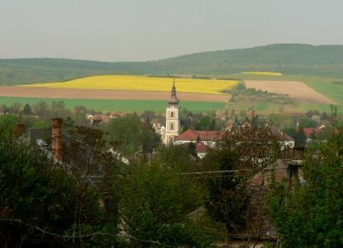
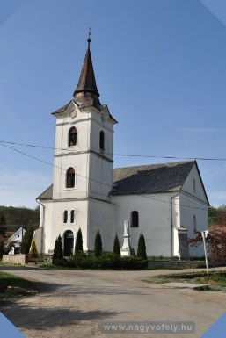
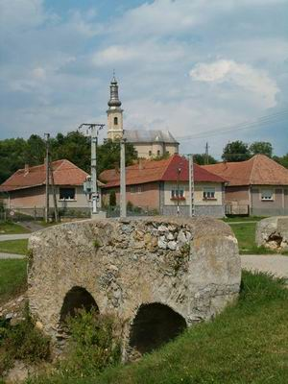
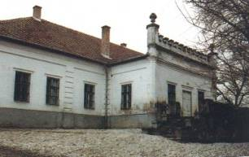
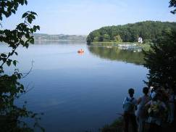

2017 XII. Vitézlő
Check Points
Bódvaszilas
Szalonna
Csehi
Hídvégardő
Martonyi Kolostor
Ördög gát
Várdomb
Szögliget
Kilátó
Meszes
Égerszög
Abod
VÁR
Galvács
Rakaca
Csáky kastély
Szendrői Természetjáró Szakosztály
Notes:
1

Slide 9
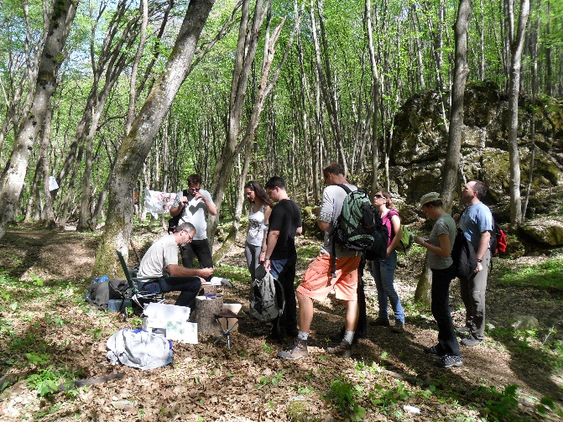
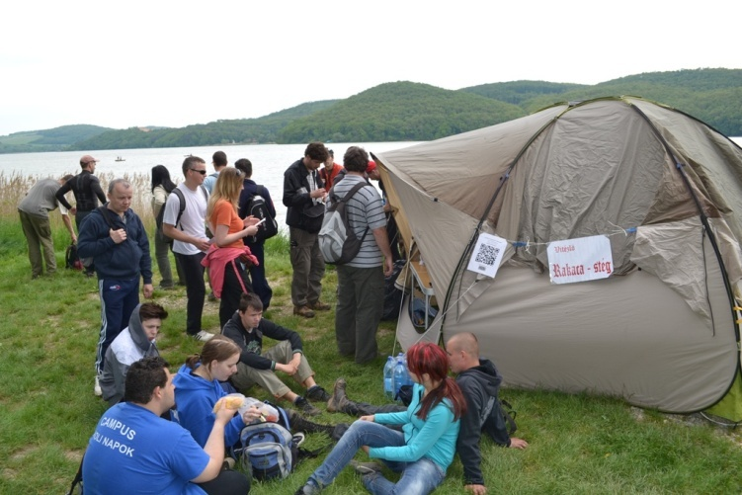
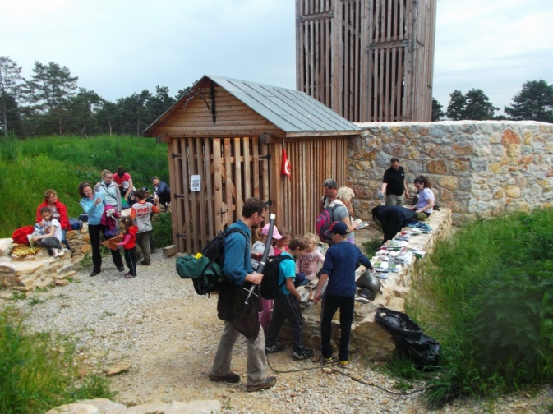
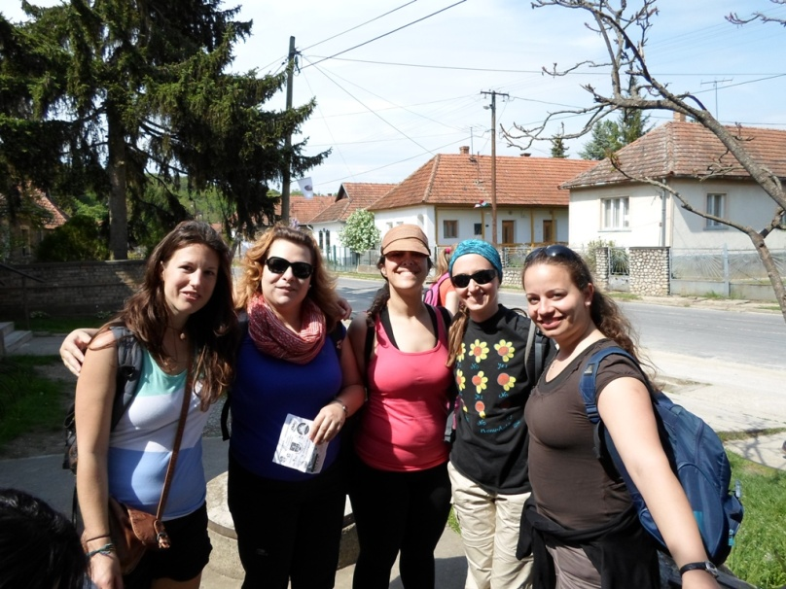
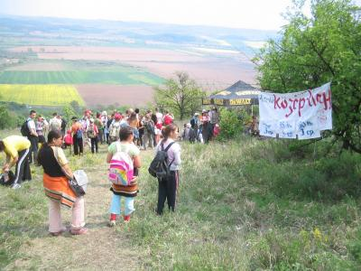
Vitézlő Check Point
Snap Shots

Slide 10
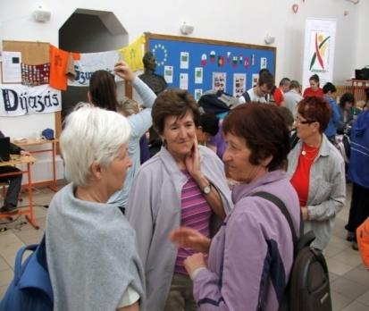
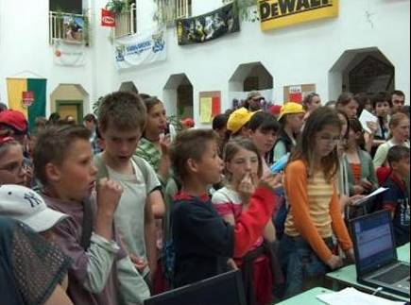
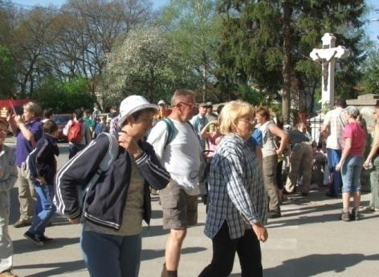
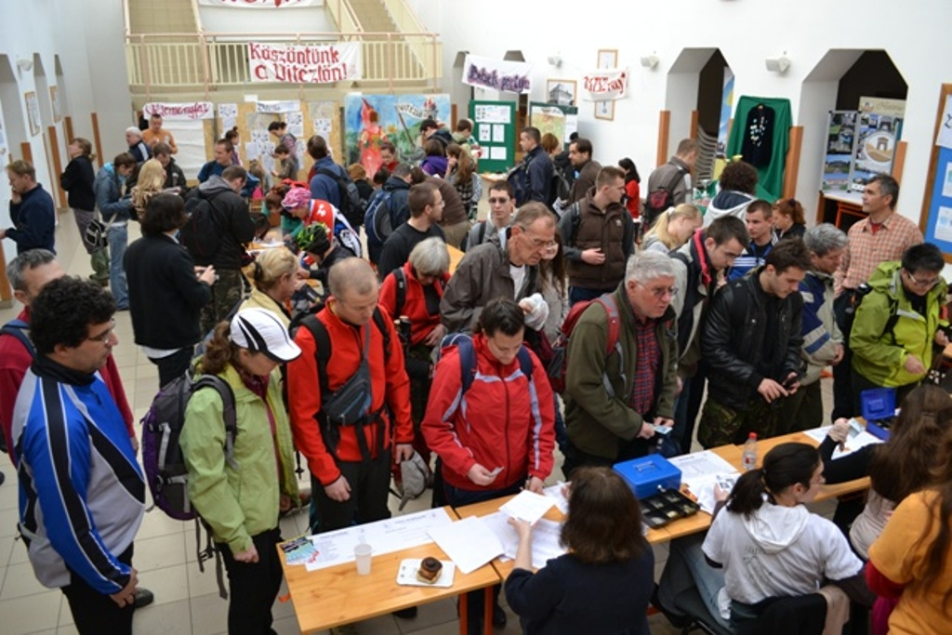
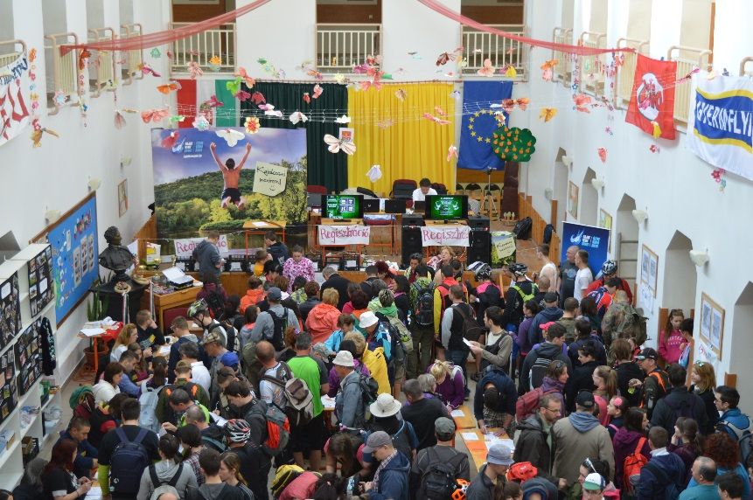
Vitézlő rajt cél

Slide 11

More information here: www.szendroitura.hu
Everyone is cordially invited to the event on April 21-23, 2017

